Slide 1
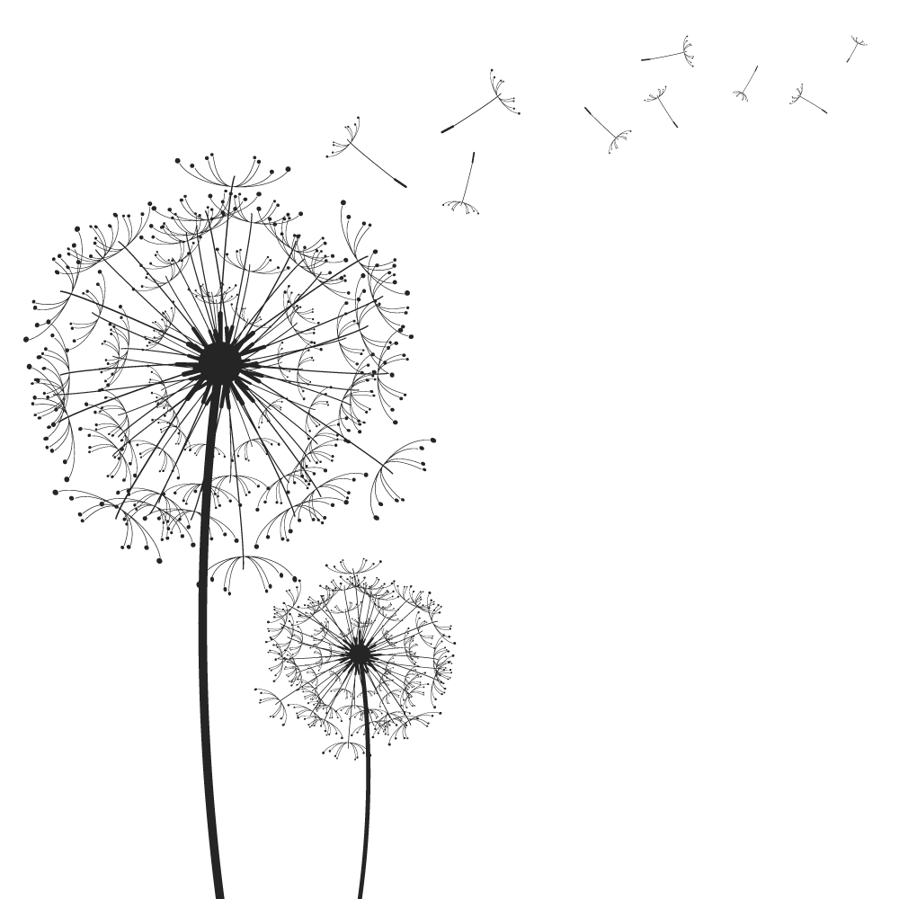
Adversarial ML

Slide 2
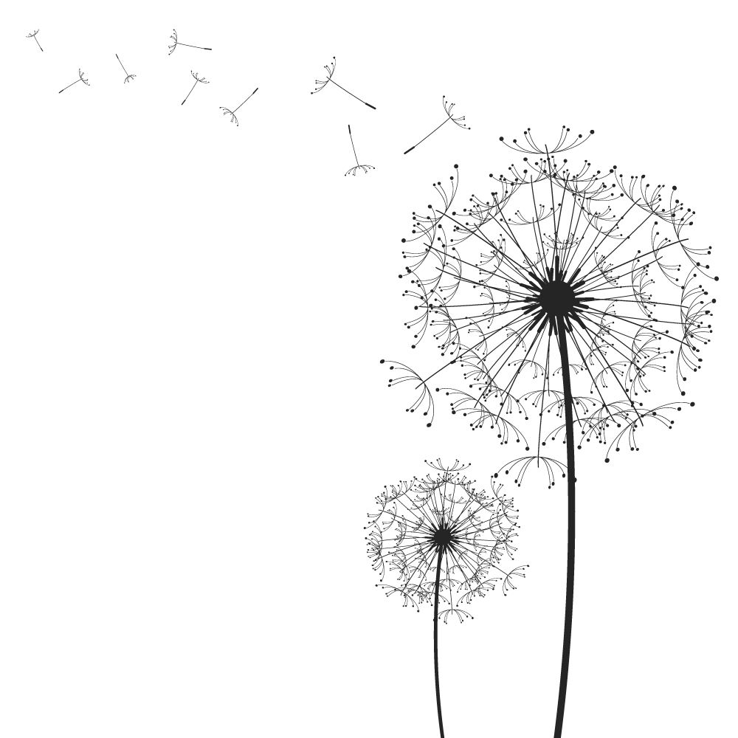
常見名詞
Part.1

Slide 3
常見名詞
Threat Model | Adversarial Falsification | False Negative(FN) (Adversarial example) | FGSM、L-BFGS、DeepFool、Uni. perturbations、C&W
 |  | False Positive(FP) (Fooling example)
 | Adversary’s Knowledge | White-Box | FGSM、L-BFGS、DeepFool、Uni. perturbations、C&W
 |  | Black-Box
 | Adversarial Specificity | Targeted | L-BFGS、C&W
 |  | Non-Targeted | FGSM、DeepFool、Uni. perturbations
 | Attack Frequency | One-time | FGSM
 |  | Iterative | L-BFGS、DeepFool、Uni. perturbations、C&W
Yuan, X., He, P., Zhu, Q., & Li, X. (2019). Adversarial examples: Attacks and defenses for deep learning. IEEE transactions on neural networks and learning systems. [Online]. Available: https://arxiv.org/abs/1712.07107
Notes:
https://glassboxmedicine.files.wordpress.com/2019/02/confusion-matrix.png

Slide 4
常見名詞
Perturbation | Perturbation Scope | Individual | FGSM、L-BFGS、DeepFool、C&W
 |  | Universal | Uni. perturbations
 | Perturbation Limitation | Optimized | L-BFGS、DeepFool、Uni. perturbations、C&W
 |  | Constraint
 |  | None | FGSM
 | Perturbation Measurement (ℓp) | p=0 | C&W
 |  | p=1
 |  | p=2 | L-BFGS、Uni. perturbations、DeepFool、C&W
 |  | p=∞ | FGSM、DeepFool、Uni. perturbations、C&W
Yuan, X., He, P., Zhu, Q., & Li, X. (2019). Adversarial examples: Attacks and defenses for deep learning. IEEE transactions on neural networks and learning systems. [Online]. Available: https://arxiv.org/abs/1712.07107
Notes:
優化擾動(optimized perturbation)和約束擾動(constrained perturbation)：前者表示擾動大小作為優化過程中的優化目標，後者表示所添加擾動僅需滿足約束即可。前者最典型的代表算法是C&W[6]
不同的擾動大小的衡量標準：lp是最常用的衡量標準，此外還有一種新提到的心理測量感知對抗相似度評分(Psychometric perceptual adversarial similarity score,PASS)[7]

Slide 5
攻擊
Part.2

Slide 6
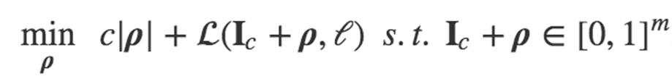
Box-Constrained L-BFGS
第一篇提出「Adversarial Example」概念
Results in the exact solution for a classifier that has a convex loss function.
Make us understand better the input-to-output mapping represented by the trained network.
C. Szegedy et al. (2013). “Intriguing properties of neural networks.” [Online]. Available: https://arxiv.org/abs/1312.6199

Slide 7
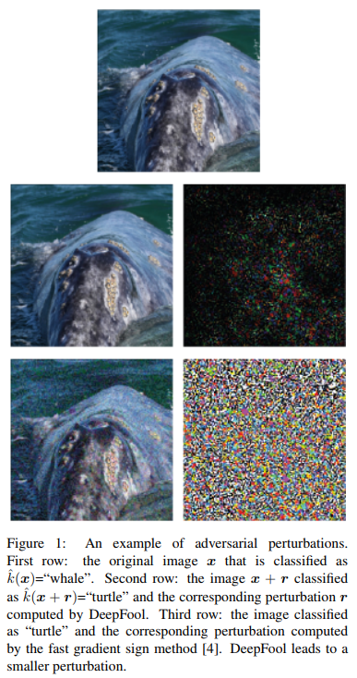
DeepFool
To find a minimal norm adversarial perturbation for a given image in an iterative manner
How: 推到分類器的邊界
S.-M. Moosavi-Dezfooli, A. Fawzi, and P. Frossard, “Deepfool: a simple and accurate method to fool deep neural networks,” in Proceedings of the IEEE Conference on Computer Vision and Pattern Recognition (CVPR), 2016, pp. 2574–2582 [Online]. Available: https://arxiv.org/abs/1511.04599

Slide 8
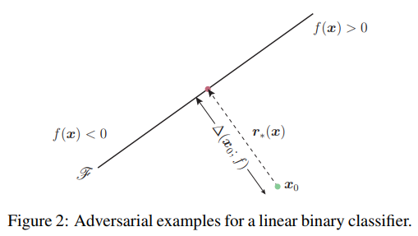
DeepFool
S.-M. Moosavi-Dezfooli, A. Fawzi, and P. Frossard, “Deepfool: a simple and accurate method to fool deep neural networks,” in Proceedings of the IEEE Conference on Computer Vision and Pattern Recognition (CVPR), 2016, pp. 2574–2582 [Online]. Available: https://arxiv.org/abs/1511.04599

Slide 9
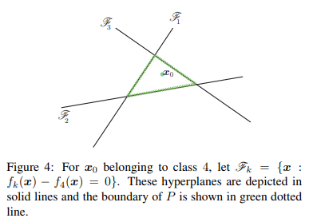
DeepFool
S.-M. Moosavi-Dezfooli, A. Fawzi, and P. Frossard, “Deepfool: a simple and accurate method to fool deep neural networks,” in Proceedings of the IEEE Conference on Computer Vision and Pattern Recognition (CVPR), 2016, pp. 2574–2582 [Online]. Available: https://arxiv.org/abs/1511.04599

Slide 10
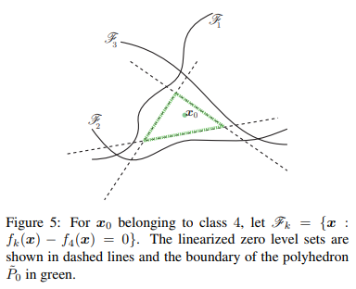
DeepFool
S.-M. Moosavi-Dezfooli, A. Fawzi, and P. Frossard, “Deepfool: a simple and accurate method to fool deep neural networks,” in Proceedings of the IEEE Conference on Computer Vision and Pattern Recognition (CVPR), 2016, pp. 2574–2582 [Online]. Available: https://arxiv.org/abs/1511.04599

Slide 11
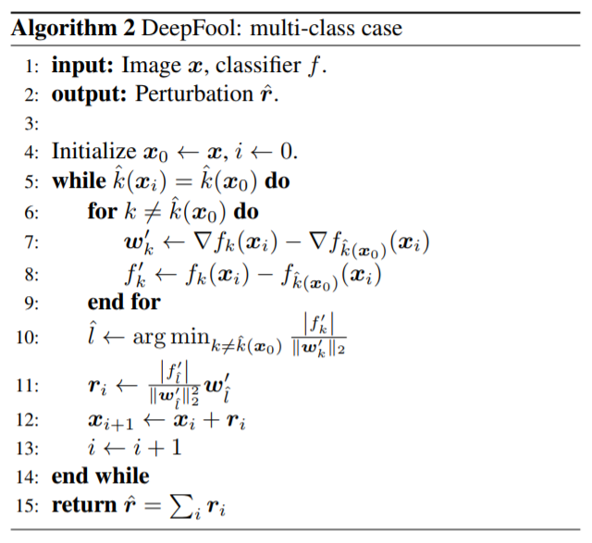
DeepFool
S.-M. Moosavi-Dezfooli, A. Fawzi, and P. Frossard, “Deepfool: a simple and accurate method to fool deep neural networks,” in Proceedings of the IEEE Conference on Computer Vision and Pattern Recognition (CVPR), 2016, pp. 2574–2582 [Online]. Available: https://arxiv.org/abs/1511.04599

Slide 12
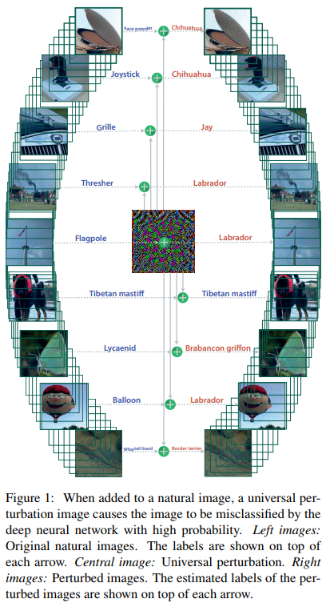
Universal adversarial perturbations
To find a single pertubation which is able to fool a network on “any” image with high confidience
How: 漸進的推進到分類的邊界
S.-M. Moosavi-Dezfooli, A. Fawzi, O. Fawzi, and P. Frossard, “Universal adversarial perturbations,” in Proceedings of the IEEE Conference on Computer Vision and Pattern Recognition (CVPR), 2017. [Online]. Available: https://arxiv.org/abs/1610.08401

Slide 13

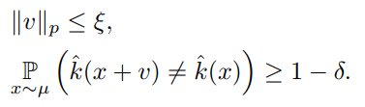
Universal adversarial perturbations
Goal
Constraints
擾動不能過大
成功率要夠高
S.-M. Moosavi-Dezfooli, A. Fawzi, O. Fawzi, and P. Frossard, “Universal adversarial perturbations,” in Proceedings of the IEEE Conference on Computer Vision and Pattern Recognition (CVPR), 2017. [Online]. Available: https://arxiv.org/abs/1610.08401

Slide 14
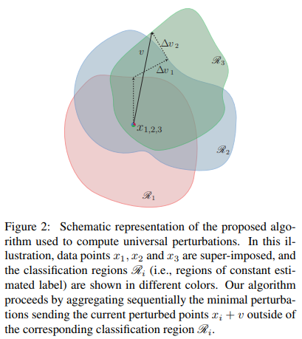
Universal adversarial perturbations
S.-M. Moosavi-Dezfooli, A. Fawzi, O. Fawzi, and P. Frossard, “Universal adversarial perturbations,” in Proceedings of the IEEE Conference on Computer Vision and Pattern Recognition (CVPR), 2017. [Online]. Available: https://arxiv.org/abs/1610.08401

Slide 15




Universal adversarial perturbations
Algorithm
If v not best pertubation:
To fit constraint-1:
Update v:
Stop when:
S.-M. Moosavi-Dezfooli, A. Fawzi, O. Fawzi, and P. Frossard, “Universal adversarial perturbations,” in Proceedings of the IEEE Conference on Computer Vision and Pattern Recognition (CVPR), 2017. [Online]. Available: https://arxiv.org/abs/1610.08401

Slide 16
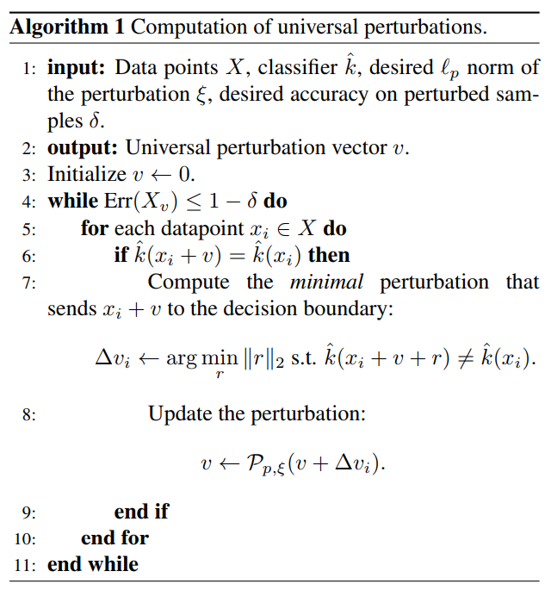
Universal adversarial perturbations
S.-M. Moosavi-Dezfooli, A. Fawzi, O. Fawzi, and P. Frossard, “Universal adversarial perturbations,” in Proceedings of the IEEE Conference on Computer Vision and Pattern Recognition (CVPR), 2017. [Online]. Available: https://arxiv.org/abs/1610.08401

Slide 17
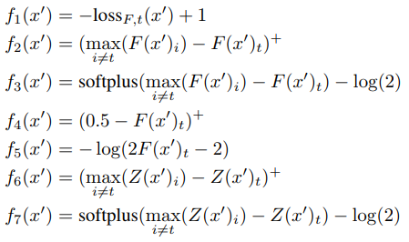
CARLINI AND WAGNER ATTACKS (C&W)
The objective function to change the label vector
N. Carlini and D. Wagner, “Towards evaluating the robustness of neural networks,” in Security and Privacy (S&P), 2017 IEEE Symposium on. IEEE, 2017, pp. 39–57. [Online]. Available: https://arxiv.org/abs/1608.04644

Slide 18
CARLINI AND WAGNER ATTACKS (C&W)
An aderverial method to attack defensive distillation(防禦性蒸餾)
攻擊防禦性蒸餾模型實際上很簡單，不考慮這些其他的類向量值，只考慮需要超過的類向量(目標類)和自身的類向量值即可，甚至可以只關注增加自身的類向量
Ex:
[ -674.3225 , -371.59705 , -177.78831 , 562.87225 ,-1313.5781 , 998.18207 , -886.97107 , -511.58194 ,-126.719666, -43.129272]
N. Carlini and D. Wagner, “Towards evaluating the robustness of neural networks,” in Security and Privacy (S&P), 2017 IEEE Symposium on. IEEE, 2017, pp. 39–57. [Online]. Available: https://arxiv.org/abs/1608.04644

Slide 19

CARLINI AND WAGNER ATTACKS (C&W)
Box Constraint
N. Carlini and D. Wagner, “Towards evaluating the robustness of neural networks,” in Security and Privacy (S&P), 2017 IEEE Symposium on. IEEE, 2017, pp. 39–57. [Online]. Available: https://arxiv.org/abs/1608.04644

Slide 20

CARLINI AND WAGNER ATTACKS (C&W)
To solve box constraints
投影梯度下降法:對於具有復雜更新步驟的梯度下降方法（例如，具有動量的梯度下降），效果不佳
裁剪梯度下降法:將裁剪直接放入了優化目標，但容易卡在平坦區域，x卡在邊界值動不了
改變變量:用新的變量w代替原先的x(本篇作者的用法)
N. Carlini and D. Wagner, “Towards evaluating the robustness of neural networks,” in Security and Privacy (S&P), 2017 IEEE Symposium on. IEEE, 2017, pp. 39–57. [Online]. Available: https://arxiv.org/abs/1608.04644

Slide 21
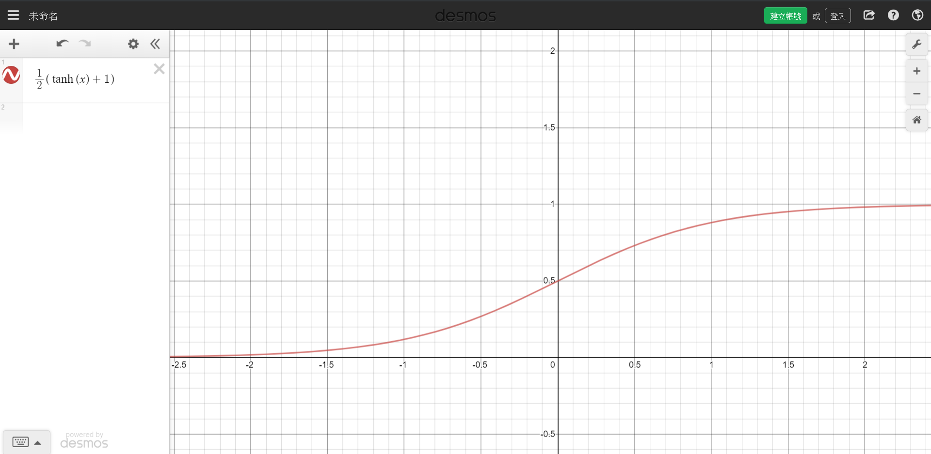
CARLINI AND WAGNER ATTACKS (C&W)
N. Carlini and D. Wagner, “Towards evaluating the robustness of neural networks,” in Security and Privacy (S&P), 2017 IEEE Symposium on. IEEE, 2017, pp. 39–57. [Online]. Available: https://arxiv.org/abs/1608.04644

Slide 22
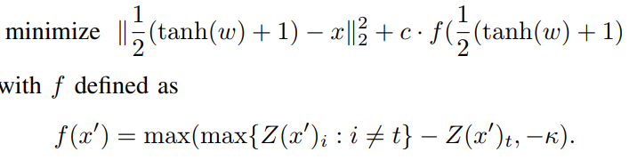
CARLINI AND WAGNER ATTACKS (C&W)
How: L2 attack
Chose the target label t
Our goal is to optimize:
by adjusting c: from 10^-4 to 10^10;
by adjusting k: 錯誤分類發生的置信度
N. Carlini and D. Wagner, “Towards evaluating the robustness of neural networks,” in Security and Privacy (S&P), 2017 IEEE Symposium on. IEEE, 2017, pp. 39–57. [Online]. Available: https://arxiv.org/abs/1608.04644

Slide 23
防禦
Part.2

Slide 24
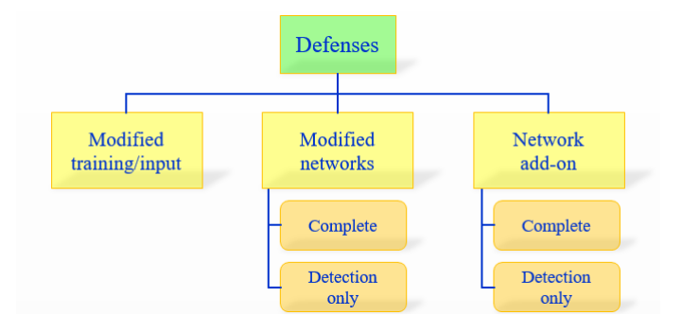
架構
三種防禦方法
Training時修改訓練集或testing時修改測試樣本
更改網路架構-training
外接其他網路-testing
兩種對抗程度
Complete-能辨識回原本label
Detection only-僅辨識是否為攻擊樣本並拒絕分類
Akhtar, N., & Mian, A. (2018). Threat of adversarial attacks on deep learning in computer vision: A survey. IEEE Access, 6, 14410-14430. [Online]. Available: https://arxiv.org/abs/1801.00553

Slide 25
Brute-Force Adversarial Training
Modified Training/Input
使用adversarial training的方法，需要來自強大攻擊方法的樣本增加訓練集，使模型正規化，減少overfitting
Virtual Adversarial Training
缺點：依舊能找出新漏洞
Notes:
VAT
http://www.twistedwg.com/2018/12/04/VAT.html
Stability training
https://arxiv.org/abs/1604.04326

Slide 26
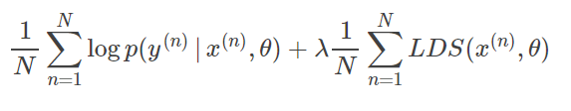


Virtual Adversarial Training(VAT)
目標函數
定義LDS
定義Rv-adv
Miyato, T., Maeda, S. I., Koyama, M., & Ishii, S. (2018). Virtual adversarial training: a regularization method for supervised and semi-supervised learning. IEEE transactions on pattern analysis and machine intelligence, 41(8), 1979-1993. [Online]. Available: https://arxiv.org/abs/1704.03976
Notes:
https://blog.csdn.net/kearney1995/article/details/79970934

Slide 27
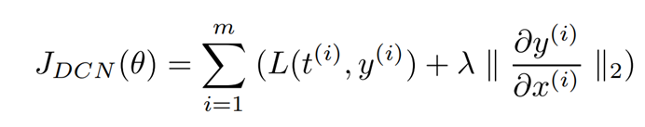
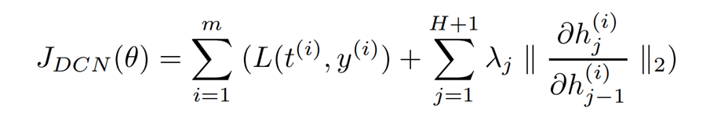
Deep Contractive Network
Modifying the Network
借由類似Contractive Auto Encoders的平滑度懲罰項，可防禦L-BGFS
Loss function
T:target
Y:model prediction
Loss function(layer wise)
h:h-th hidden layer
Gu, S., & Rigazio, L. (2014). Towards deep neural network architectures robust to adversarial examples. arXiv preprint arXiv:1412.5068. [Online]. Available: https://arxiv.org/abs/1412.5068

Slide 28
Gradient Regularization/Masking
Modifying the Network
training時減少gradient的變化，或隱藏gradient，有利於對抗基於gradient的攻擊方法
Masking-based Defense
通過在網絡的logit輸出中添加noise，實現了masking based的對於C&W攻擊的防禦。
Notes:
Masking based
https://arxiv.org/abs/1709.04447
https://blog.csdn.net/a1065147740/article/details/83999473

Slide 29

A Learning and Masking Approach to Secure Learning
攻擊方法: ALN
防禦方法: DLN、NAC
DLN
去噪前後相似
去噪後要能辨識回原類別
Cat(y)-原類別、D(x)-去噪器、Cp(x)-分類器
NAC
對於低干擾的對抗樣本，它們大多在分類邊界附近，因此可以通過屏蔽分類邊界來愚弄低干擾對抗樣本
在模型輸出中加入noise
Nguyen, L., Wang, S., & Sinha, A. (2018, October). A learning and masking approach to secure learning. In International Conference on Decision and Game Theory for Security (pp. 453-464). Springer, Cham. [Online]. Available: https://arxiv.org/abs/1709.04447
Notes:
https://blog.csdn.net/kearney1995/article/details/79970934

Slide 30
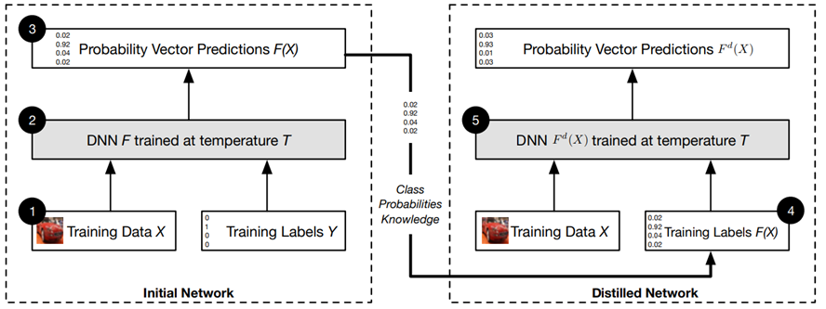
Defensive Distillation
Modifying the Network
Distillation 是指將復雜網絡的知識遷移到簡單網絡上
N. Papernot, P. McDaniel, X. Wu, S. Jha, and A. Swami, “Distillation as a defense to adversarial perturbations against deep neural networks,” in Security and Privacy (SP), 2016 IEEE Symposium on. IEEE, 2016, pp. 582–597. [Online]. Available: https://arxiv.org/abs/1712.07107 [Online]. Available: https://arxiv.org/abs/1511.04508
Notes:
Defensive Distillation
https://zhuanlan.zhihu.com/p/31177892
C&W方法據稱可以成功攻破這種防禦機制。
Extend Defensive Distillation
https://arxiv.org/pdf/1705.05264.pdf
蒸餾溫度
模型的輸出對每一個輸入分量的梯度
T越大會減少模型梯度
訓練T設大
測試T設小=>增加新樣本的敏感性

Slide 31
Detector Subnetwork
Modifying the Network-Detection Only Approaches
增加一個子網路辨識是否為擾動樣本，可防禦FGSM、BIM、DeepFool
Additional Class Augmentation
方法：增加一個class來辨識攻擊樣本
缺點：依舊會被找到漏洞
Lu, J., Issaranon, T., & Forsyth, D. (2017). Safetynet: Detecting and rejecting adversarial examples robustly. In Proceedings of the IEEE International Conference on Computer Vision (pp. 446-454). [Online]. Available: https://arxiv.org/abs/1704.00103
Notes:
SafetyNet
https://arxiv.org/pdf/1704.00103.pdf
經過ReLU會強制輸出離散的code

Slide 32
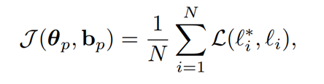
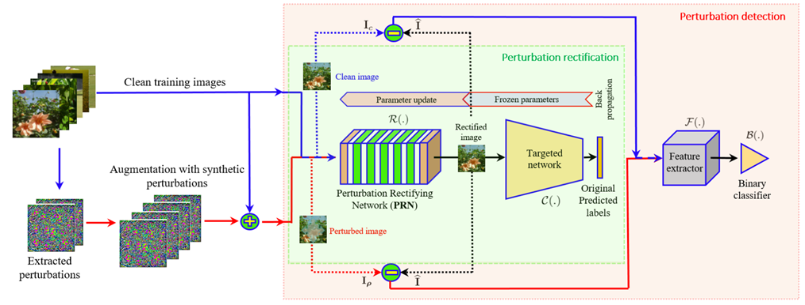
Defense Against Universal Perturbations
Network Add-ONS
增加一個預輸入層-Perturbation Rectifying Network (PRN)
Akhtar, N., Liu, J., & Mian, A. (2018). Defense against universal adversarial perturbations. In Proceedings of the IEEE Conference on Computer Vision and Pattern Recognition (pp. 3389-3398). [Online]. Available: https://arxiv.org/abs/1711.05929
Notes:
PRN loss : target network predict label (Li) and joint network predict label
當PRN偵測為攻擊樣本，由PRN輸出的圖片作為target network輸入
I-R(I)經過F後給B訓練是否為攻擊樣本
F=2D-DCT
B=SVM
測試時先給B決定是否為攻擊樣本B(F(I*))，如果是，替換R(I*)送入原C
https://arxiv.org/pdf/1711.05929.pdf

Slide 33
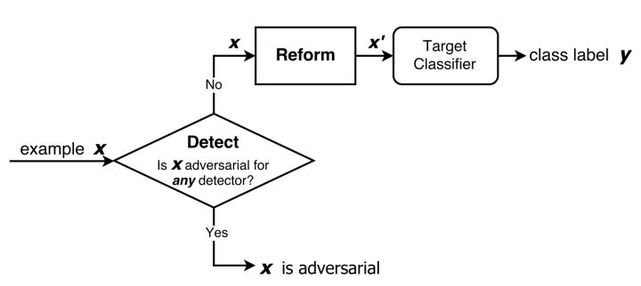
MagNet
Network Add-ONS Detection Only Approaches
訓練一個detector來辨識乾淨圖片的manifold，並訓練一個reformer來重構接近manifold邊界的圖片
Meng, D., & Chen, H. (2017, October). Magnet: a two-pronged defense against adversarial examples. In Proceedings of the 2017 ACM SIGSAC Conference on Computer and Communications Security (pp. 135-147). ACM. [Online]. Available: https://arxiv.org/abs/1705.09064
Notes:
https://zhuanlan.zhihu.com/p/30934360
基於重構誤差（reconstruction error）的Detector 由AE來實作
基於概率分歧/發散（probability divergence）的Detector 比較f(原始x)與f(AE(x))的差異(JS divergence)
Reformer x->AE(x)-來自正常樣本的AE

